Slide 1
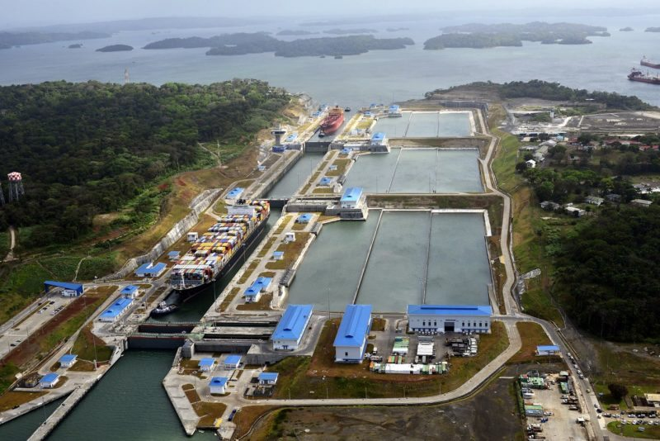
Managing the Five Dimensions of Mega-Project Complexity – A Multidisciplinary Process
Douglas D. Gransberg, PhD, PE
President
Gransberg & Associates, Inc.
Norman, OK
dgransberg@gransberg.com

Slide 2

Defining Project Complexity
College of Complex Project Managers (CCPM) says that complex projects are differentiated from routine projects
  “… degree of disorder, instability, emergence, non-linearity, recursiveness, uncertainty, irregularity and randomness”
  “to a high level of uncertainty about what the objectives are, and/or high uncertainty in how to implement the objectives”

Slide 3
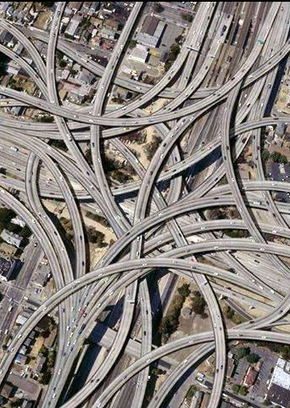
Definitions
Traditional Projects
Complex Projects
Standard practices can be used
  Design
  Funding
  Contracting
Static interactions
High level of similarity to prior projects creates certainty
Standard practices cannot be used
  Design
  Funding
  Contracting
Dynamic interactions
High level of uncertainty regarding objectives and/or implementation
Notes:
Key Message
Complex projects have different definitions depending on who you are talking to.
Background and Notes
Complex projects are characterized by a degree of disorder, instability, emergence, non-linearity, recursiveness, uncertainty, irregularity and randomness. There is dynamic complexity where the parts in a system can react/interact with each other in different ways (a chess game). There is also high uncertainty about what the objectives are and/or high uncertainty in how to implement the objectives. The level of uncertainty varies with the maturity of the individual/organization (CCPM 2006).
These projects are not going to fit in the “standard/normal” process.
Guidebook Location
Section 1.3

Slide 4

Uncertainty Drives Complexity
The CCPM maintains that “the level of uncertainty [i.e. complexity] will vary with the maturity of the individual/organization.”
The amount of uncertainty that exists in the project that is beyond the project manager’s control that makes it complex.
Managing on the edge of chaos.

Slide 5



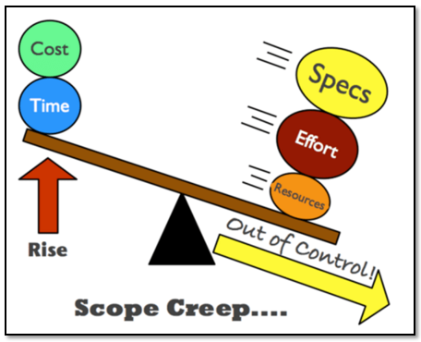
Causes of Complexity
Inexperience
Technical challenges
Non-technical challenges
Multiple funding sources
Multiple external parties
Environmental constraints
Political issues
Public relations challenges
Notes:
Key Message
There are an unlimited number of causes of complexity.
Background and Notes
There are a number of different reasons for complexity and they are different for every project. In addition, reasons for complexity today are not going to be the same three, five, or 10 years from now, as you gain more experience in an area. Complexity is going to be fluid. As an example of something we hadn’t done before but gained experience with, the first few design-build projects were complex; but, once several had been done, we knew what was going on and it was no longer the complex piece of the project.
Guidebook Location
Section 1.3
Interactivity
What are some other causes of complexity on major projects currently in your program?

Slide 6
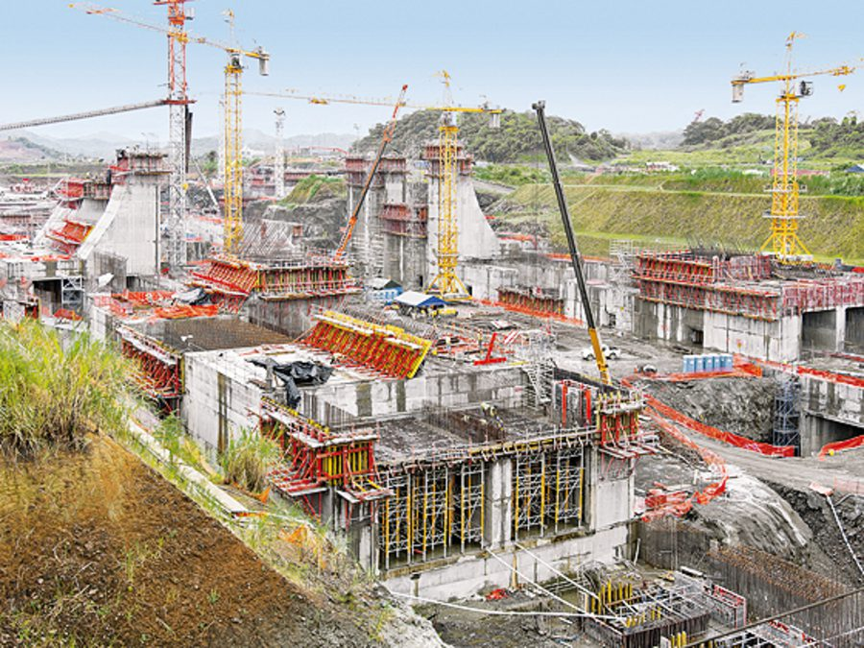
Presentation Objective
Research questions:
  Can project managers manage complexity in mega-projects?
  How can complexity be measured?
  Can the measurement be used to track complexity change over time in mega-projects?

Slide 7
Project Management - 3D versus 5D
Strategic Highway Research Program 2, Project R-10: Project Management Strategies for Complex Projects found 5 dimensions of complexity:
  Technical
  Cost
  Schedule
  Context
  Financing
Technical
Cost
Financial
Context
Schedule
5 Dimensional
Project Management

Slide 8
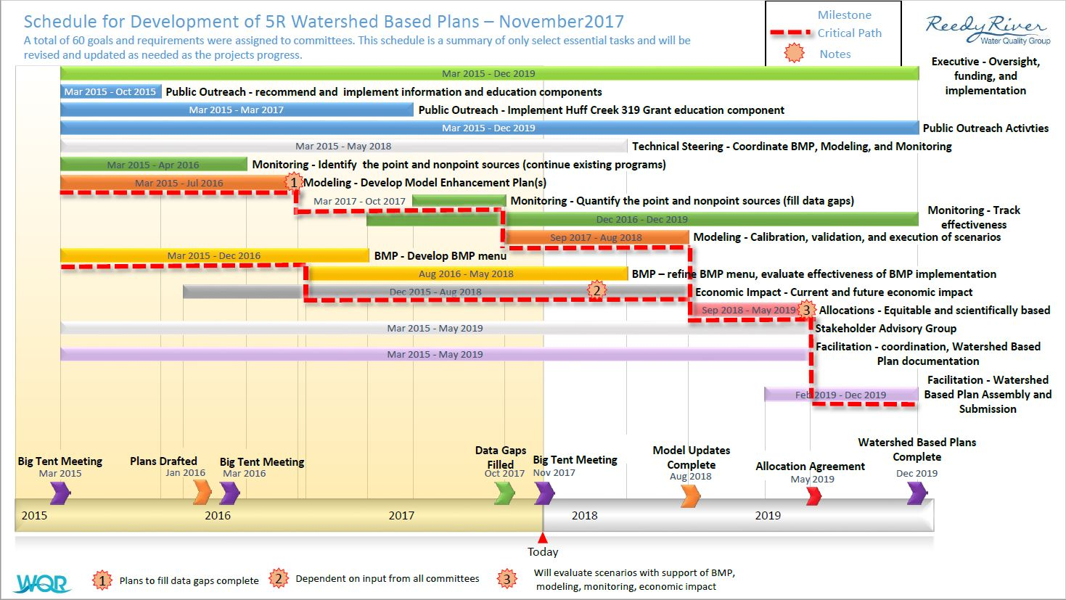

Dimensional Factors
Schedule Factors
Technical Factors
Time
Schedule risk
Prescribed milestones
Availability of resources
Notice to proceed
Statutory time limits – advertise, award, notice to proceed, etc.
Design
Scope of work
Aesthetic requirements
Quality
Need for integrated delivery

Slide 9
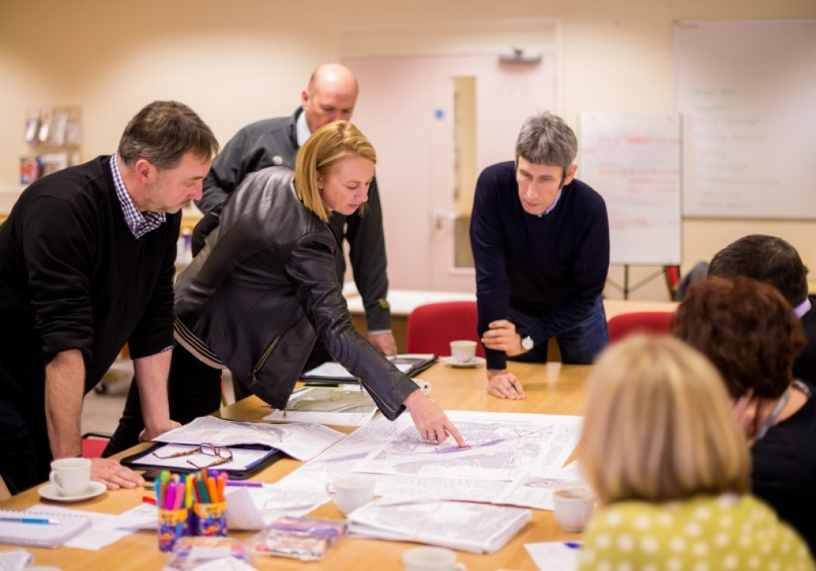
Context Dimension Factors
Political/procurement constraints
Environmental issues
Public perception
Right-of-way acquisition
Sustainability
Owner preferences/biases
Utilities

Slide 10
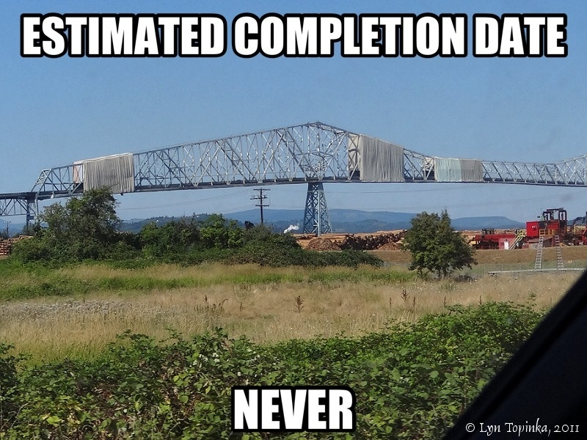
Example of the Context Dimensional Complexities
Lewis and Clark Bridge over the Columbia River, Oregon and Washington: Bridge closure and local hospital is on one side, and allowable detour period is hours.
Note – Picture came from a local project opponent’s blog – public opinion…. Also context

Slide 11

Cost Dimension vs. Financing Dimension
Financing Factors
Source of funds
Schedule of fund availability
Cash flow
Public Private Partnerships (P3)
Cost Factors
Estimates
Scope of work
Quantities
Right of way (ROW) acquisition
Requirements needing funding

Slide 12
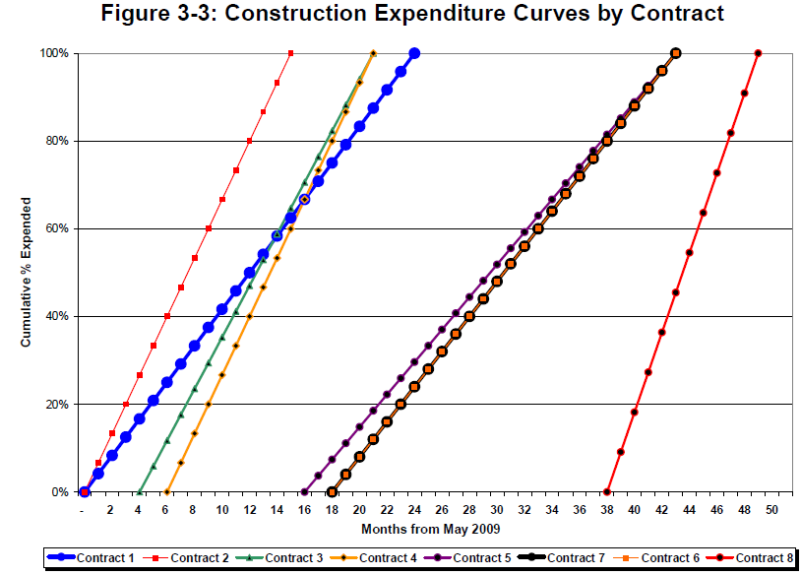
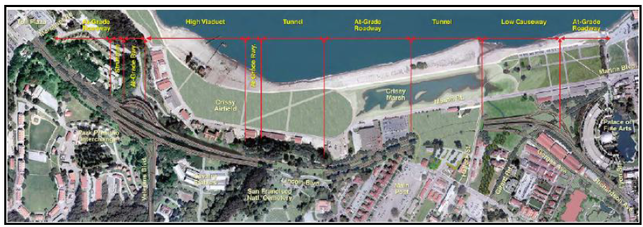
Example of Finance Dimensional Complexities
Doyle Drive, San Francisco, California:
I-595 Design-Build-Operate-Finance-Maintain with tolling revenue – when are different sources of funding actually available for use?
Multi-jurisdictional P3 – Context issues too!
Notes:
Guidebook Location
Section 2.1

Slide 13
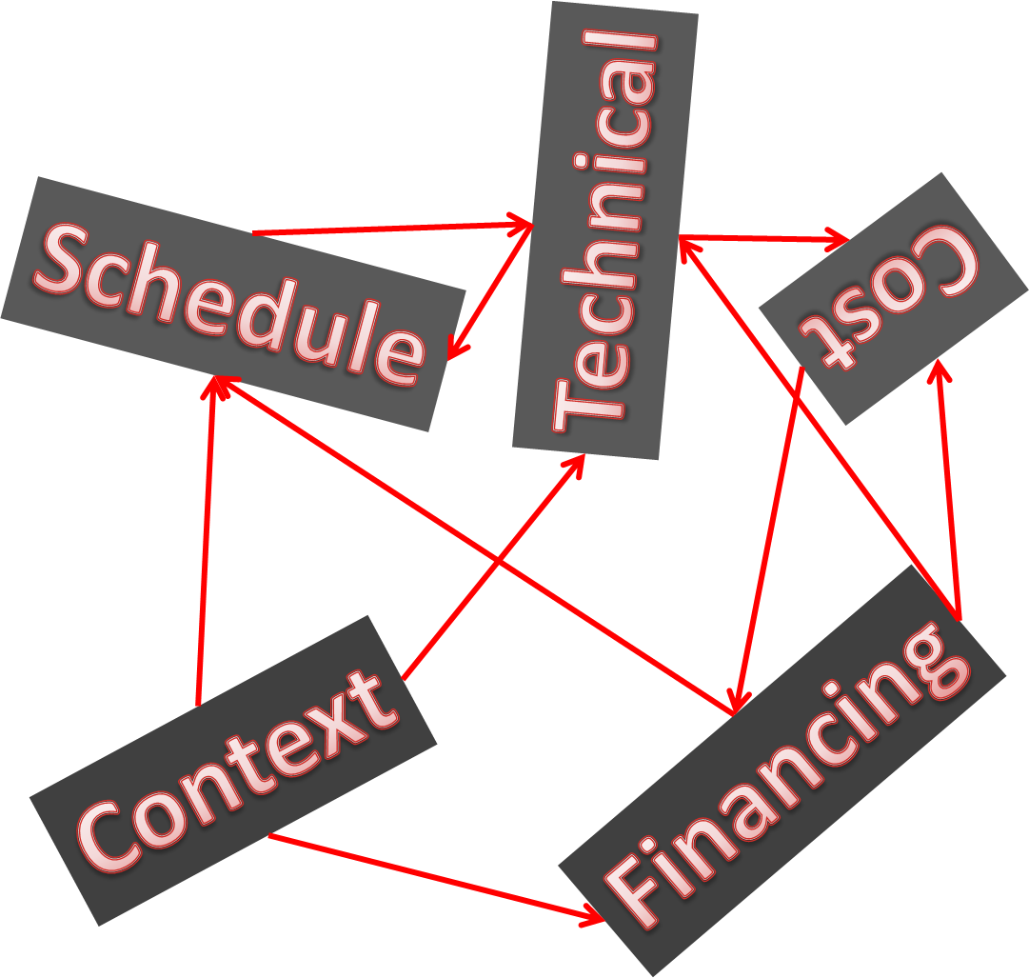
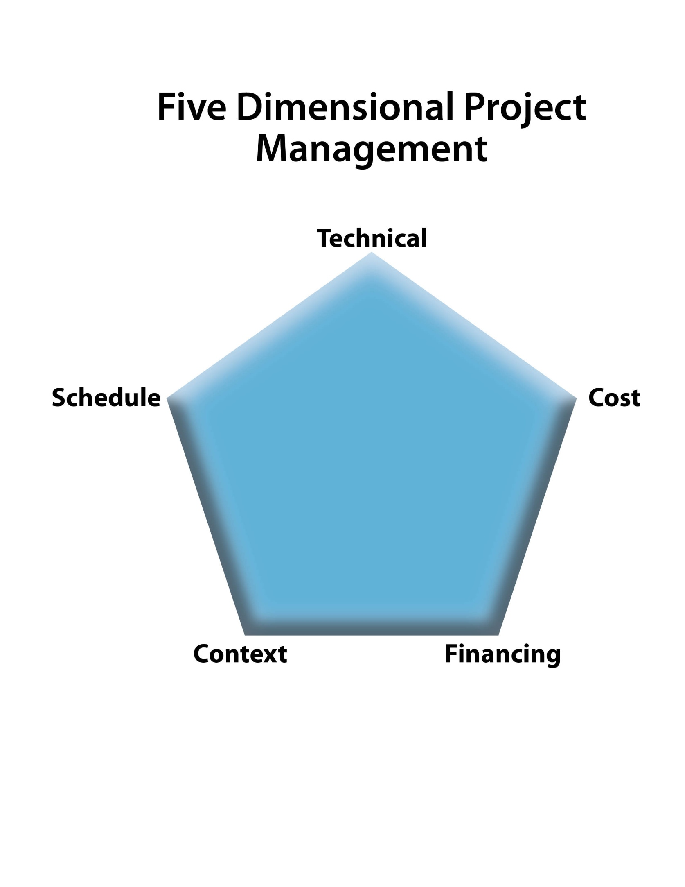
5DPM Interactions
Theoretical Model
Actual Model

Slide 14


Complex Project Management
Must manage project influences that the PM does not directly control.
Must make decisions in conditions of uncertainty.
Focus is on cost and schedule CERTAINTY – Not cost and schedule savings.

Slide 15

5-Dimensional Complex Project Management
“5DPM is a dynamic process that:
seeks first to
  identify project complexity,
  quantify its potential impact on project performance, and
then actively manage identified complexities through
  proactive resource allocation and
  early decision-making.”

Slide 16
5DPM
5 Strategic Planning Methods implemented using
24+ Project Execution Tools
Note: Arrows between levels are hypothetical.
Notes:
Key Message
5DPM uses the 5 planning methods’ project execution tool selections to form strategies that eventually form the content of the PMP.
Background and Notes
Guidebook Location

Slide 17
Can Mega-Project Complexity Be Measured?
Routine projects are treated as linear math problems
Technical = Scope of work = Cost + Schedule
  Conceptually, the 3 dimensions are in fact interrelated; therefore, in a complex project:
  Available Funds (Financing) + Context = Possible scope of work = Technical
  Technical = Cost + Schedule
  To measure complexity, one must first determine the complexity of a routine project.
  Then each dimension of the complex project can be compared to the routine.

Slide 18
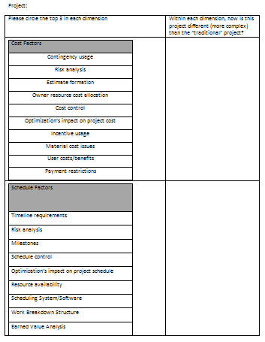
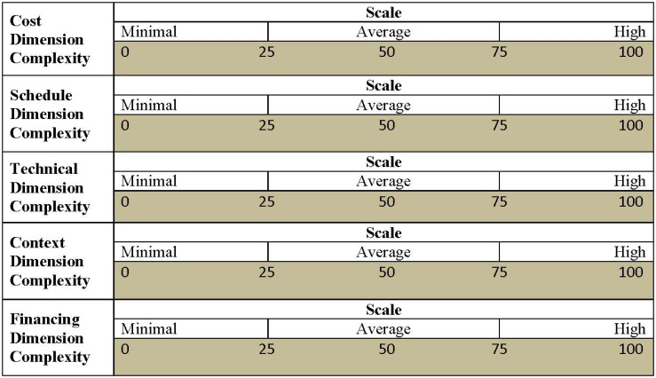
Complexity Mapping
Notes:
Key Message
A complexity map can help describe a project in terms of the five dimensions of 5DPM.
Background and Notes
Steps in developing a complexity map:
Consider factors that impact each dimension.
Score each dimension on a scale of 0-100 (normal project is 50).
Plot the project complexity.
Guidebook Location
Sections 2.2, 2.3, 2.4, and 2.5

Slide 19
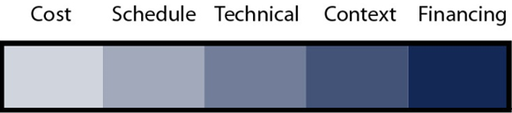
GATED 5DPM Implementation Process
Planning
Programming
Preliminary design
Final design
Construction
Operation
Complexity
Mapping
GATE5
GATE6
GATE7
GATE1
GATE2
GATE3
GATE4
5 Methods
Execution
Tools

Slide 20
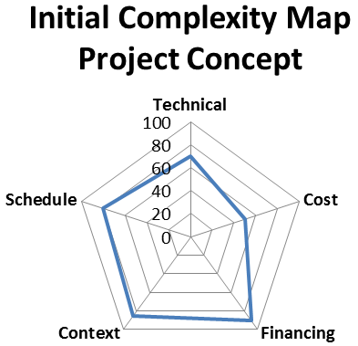
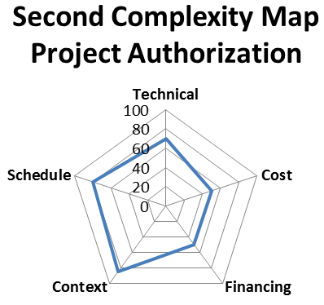
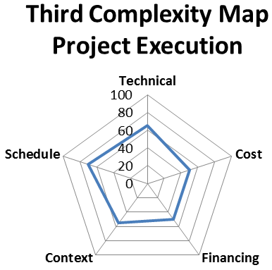
Example of Iterative Complexity Mapping
C
1. Public Info
2. Permits
B
1. Design decision
2. Precast order
GATE 1
D
1. Finance
2. Public Info
GATE 4
GATE 3
Complexity Footprint = 13434
Complexity Footprint = 10485
Average Complexity (all 50)= 5944 Max Complexity (all 100) = 23776
Complexity Footprint = 7894
Notes:
Key Message
The process of mapping the complexity of the project should happen, as a minimum, at each gate during the course of project development as the complexity or source of complexity may change.
Background and Notes
As projects develop the dynamics of the project change, especially in complex projects. It may be helpful to re-map the complexity of the project several times throughout project duration to see where changes are occurring. This may shift the resources for the project.
Guidebook Location
Section 2.6

Slide 21
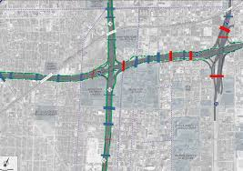
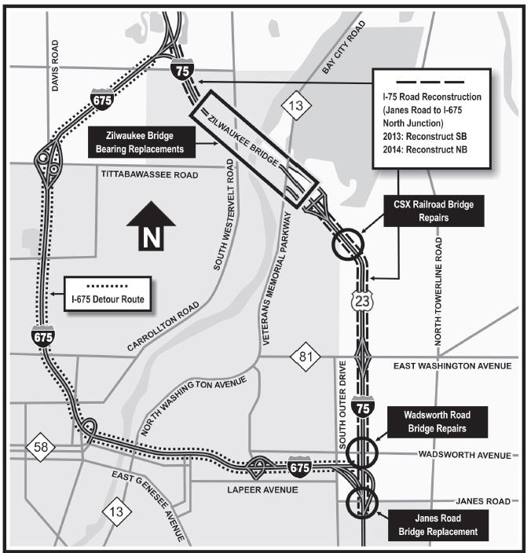
Michigan Case Study Mega-Projects
Area | I-75 Goals | I-94 Goals
Mobility | Maintain regional mobility for public users | Maintain regional mobility for freight users
Budget | Deliver for < $800 million | Deliver for < $1.5 billion
Schedule | Deliver in 4 years | Deliver in 4 years
Competition | Maximize local contractors’ opportunities | Maximize local contractors’ opportunities
Scope | 17.7 miles reconstruction and widening; Add one lane in each direction; Replace 16 bridges; Improve drainage | 6.7 miles reconstruction and widening; Add one lane in each direction; Replace 10 bridges; Add new service drive system on perimeter

Slide 22
Michigan I-75 Complexity Ratings
Dimension | I-75 Project
 | 2012 | 2013 | 2014
Cost | 60 | 60 | 60
Schedule | 85 | 75 | 78
Technical | 50 | 70 | 62
Context | 80 | 85 | 80
Finance | 70 | 80 | 75
Area | 11,056 | 12958 | 11872

Slide 23
Michigan I-94 Complexity Ratings
Dimension | I-94 Project
 | 2012 | 2013 | 2014
Cost | 80 | 70 | 70
Schedule | 90 | 82 | 85
Technical | 70 | 80 | 80
Context | 100 | 100 | 100
Finance | 89 | 85 | 75
Area | 17419 | 16453 | 15811

Slide 24
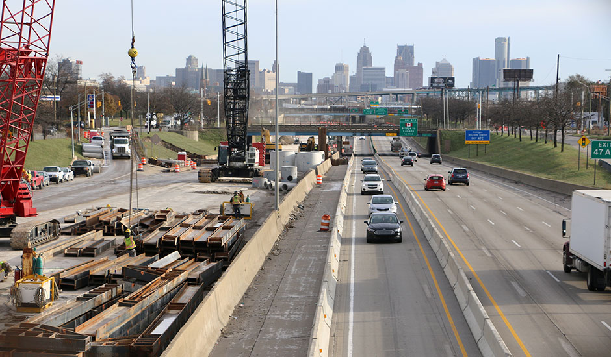
Summary: Case Study Example
“Project management is about resolving a problem need.” (Joham et al. 2009)
To do so requires:
  Effective prioritization of project resources
  Assignment to those needs that creating complexity
I-94’s financing issue caused a delay in I-75’s schedule.
The result was political issues increasing both project’s context dimension

Slide 25
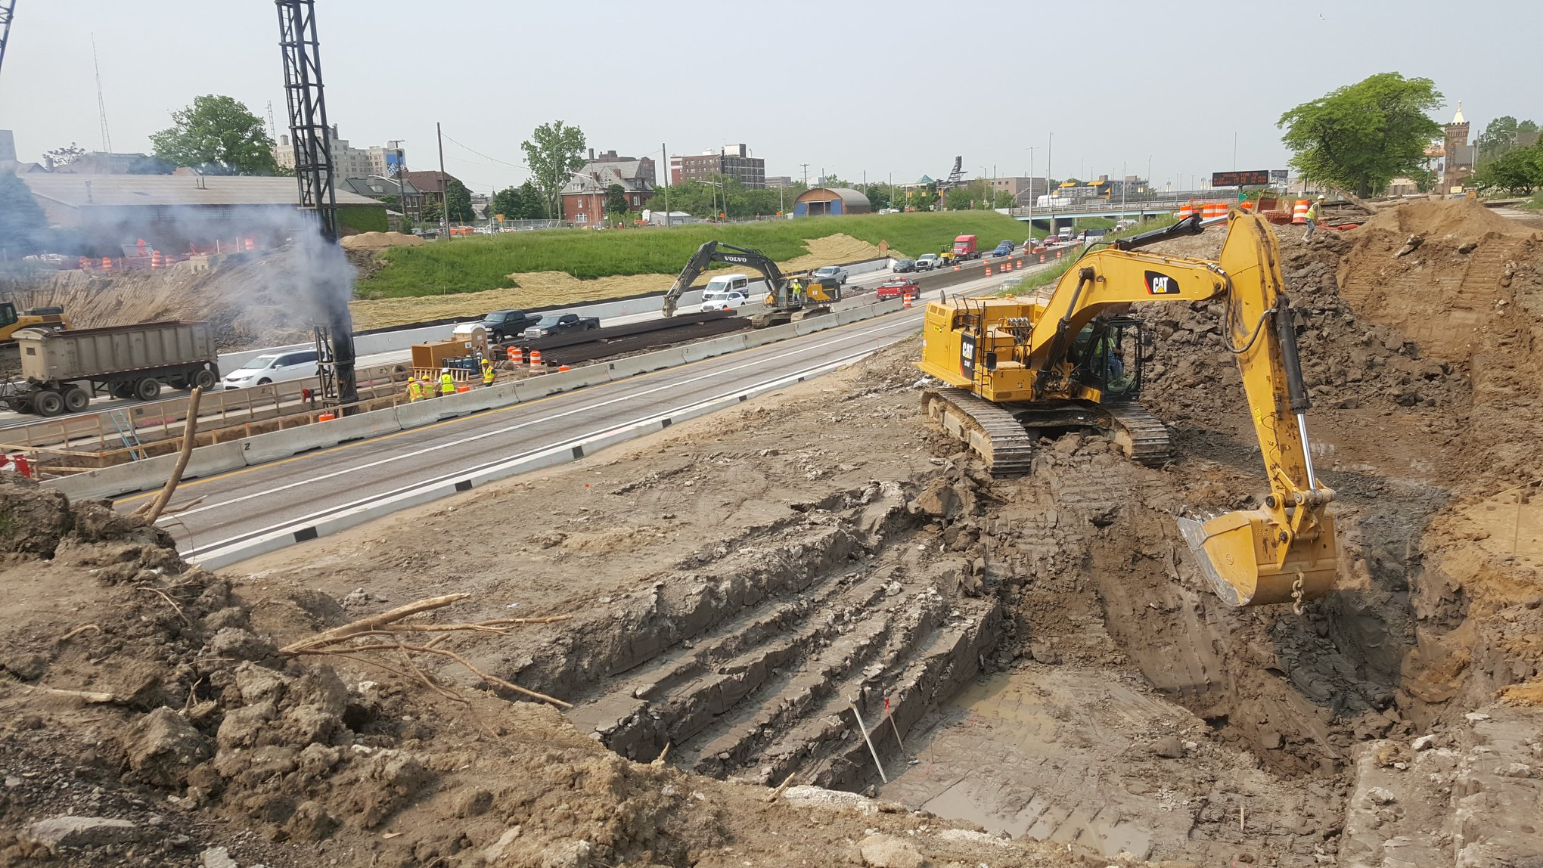
Conclusions: Case Study Example
Complexity mapping assists the complex project manager and its team to visualize the impact of their resource allocation decisions.
Across three samplings, the two teams were able to ultimately reduce the overall complexity of each project.
That is the definition of success in complex mega-project management.

Slide 26
Hypothetical Application of 5DPM in Panama Canal Expansion Program
Method 1: Identify Critical Success Factors
Most Complex |  |  |  | Least Complex
Schedule | Technical | Context | Cost | Financing
Minimize impact to traffic in existing canal: Maintain preconstruction throughput. | Insufficient water in Lake Gatun for gravity flow: Provide water recovery system for ~60% flow. | Minimize impact to environment: Relocate crocodiles and other impacted species. | Account for differing site conditions: Develop geotechnical baseline report. | ???.
Method 2: Assemble Project Team
  Use design-build project delivery to provide integration of design and construction teams with ACP.

Slide 27


Hypothetical Application of 5DPM in Panama Canal Expansion Program
Method 3: Select Project Arrangements
  Establish ACP canal expansion program team as a separate administrative entity.
  Empower team to make the necessary decisions to keep projects on budget and schedule.
  Provide team with training on design-build project delivery
Method 4: Early Cost Model and Finance Plan
  Develop project-level cost models.
  Develop program-level financing plans.

Slide 28
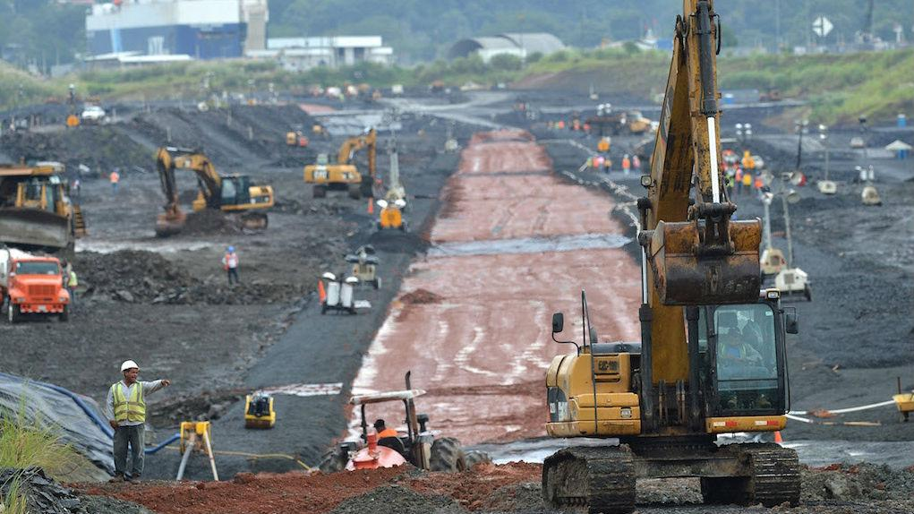
Hypothetical Application of 5DPM in Panama Canal Expansion Program
Method 5: Develop Targeted Action Plans
  Procurement strategy
  Design-Build design administration
  Environmental protection and mitigation
  Geotechnical risk management
  Etc.
Select Project Executions Tools for Each Plan
  Design-Build design administration plan
    Determine work package/sequence
    Design decision register
    Design to budget
  Geotechnical Risk Management
    Risk retirement plan

Slide 29
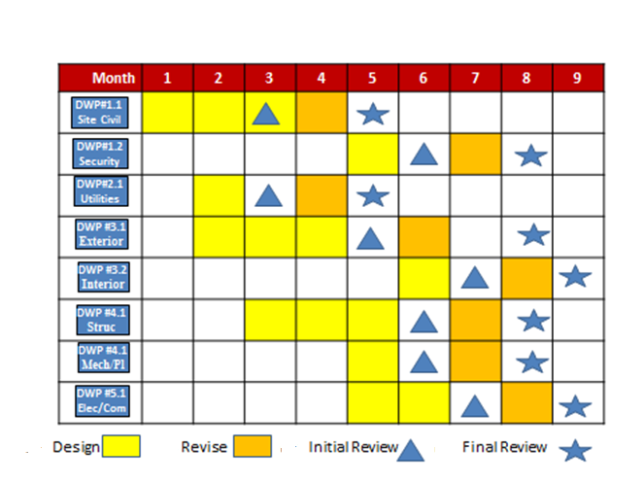
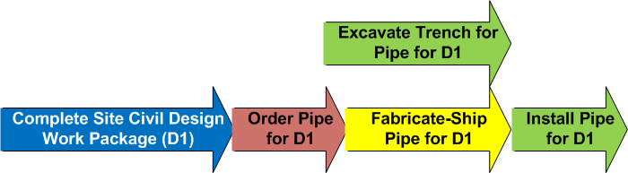
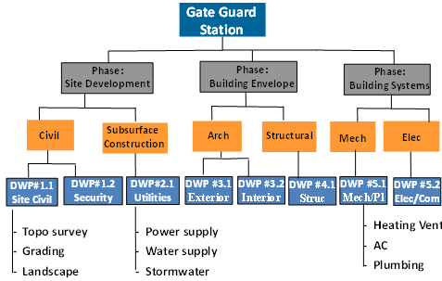
Design/Construction Sequence of Work
Design Work Breakdown Structure
Design Work Package Schedule
Construction Work Package Sequence

Slide 30
Design Decision Register

Slide 31
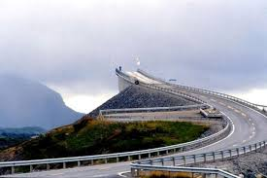
Design to budget
Complicated funding systems
  Expiring appropriations
  Portions of the project are underwritten by debt instruments
  Entire project funding may not even be identified or secured
Steps
Identify cost and schedule constraints.
Establish maximum budget and schedule and develop design options.
Confirm cost and schedule values.
Use a tracking log and begin approval process for design exceptions.
Clearly communicate cost and schedule constraints.
Failure to design to budget result!

Slide 32
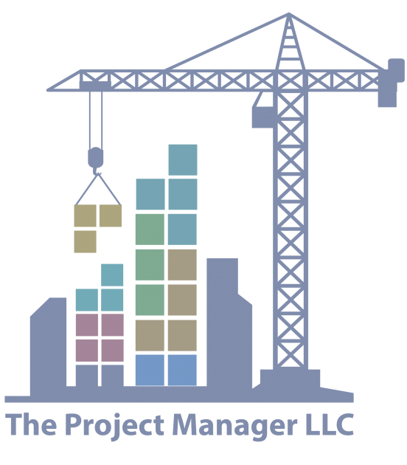
Risk Retirement Plan
Risk exposure dates correlated to schedule
Exposure passed dates become schedule milestones
Retire risk after exposure is passed
Release contingencies as risks are retired.
Line Item Contingencies Released to PM
$
$
$

Slide 33
Conclusions
5DPM merely RESTRUCTURES the project team’s thought process by:
  Elevating context and finance to the same level as cost, schedule, and technical
  Emphasizing parallel rather than linear project development
  Early consideration of all factors that create complexity
Planning methods and execution tools form the project delivery strategy for a given complex megaproject’s PMP.
5DPM permits the measurement of complexity in a meaningful manner that permits the PM team to use it as a project control tool.

Slide 34
Where to Next?
5DPM has been implemented by US state departments of transportation.
  Seattle Multimodal Terminal at Colman Dock GC/CM Project, Washington State DOT, $268 million
  I-95 Northbound Viaduct Project, Rhode Island DOT, $135 million
  I-293 EXITS 6 & 7 Project, New Hampshire DOT, $128 million
  I-10 Near Term Improvements CM-at-Risk Project, Arizona DOT, $310 million
  Council Bluffs I-70 Segment 4 DBB Project, Iowa DOT, $2 billion
  Highway 20 Rehabilitation DB Project, Massachusetts DOT, $101 million
  Interstate 75 Expansion DB Project Michigan DOT, $175 million
  Interstate 94 Modernization DBB Project, Michigan DOT, $200 million
  Interstate 285 Tollway P3 Project, Georgia DOT, $1.1 billion
  Northwest Corridor Design-build-finance Project Georgia DOT, $2.5 billion
  I-10 Mobile River Bridge Project, Alabama DOT, $832 million

Slide 35
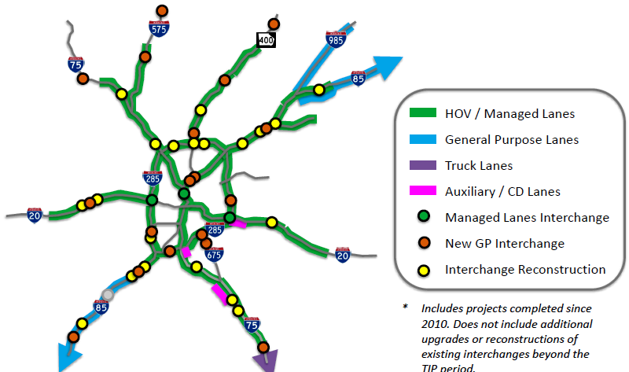
Where to Next?
The initial two 5DPM projects in Georgia were so successful that it has adopted the approach for its $11 billion Major Mobility Improvement Program.
UTP is sponsoring a 2-day workshop on October 14 and 15 in Panama City.

Slide 36





Questions ???
¿¿¿ Preguntas ???
¿¿¿ Preguntas ???

